Slide 1

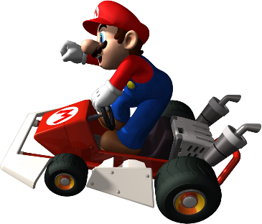

DEEP REINFORCEMENT LEARNING FOR AUTONOMOUS GAMEPLAY IN SUPER MARIO BROS
Shreyas Lingwal
23CE-38
School of Technology
Under the guidance of Mr. Jagdish Goswami

Slide 2

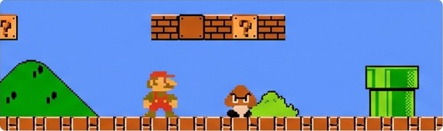



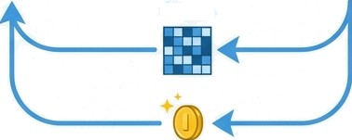
MOTIVATION
Action
A classical problem for Modern AI: Super Mario Bros is a benchmark for high dimensional visual control. An agent must learn complex concept like gravity ,momentum and energy trajectories directly from raw pixels
Agent
Environment
The Sparse Reward Challenge: In game rewards are infrequent. An agent can earn a high score for survival by simply standing still, creating a local optimum of zero progress. Our primary motivation was to overcome this policy stagnation.
A Tangible Model for Reality: This is more than a game. The agent's challenges mirror those in robotics and autonomous navigation: interpreting sensor data (pixels), avoiding dynamic obstacles (Goombas) and reaching a goal with minimal feedback.
State
Reward

Slide 3
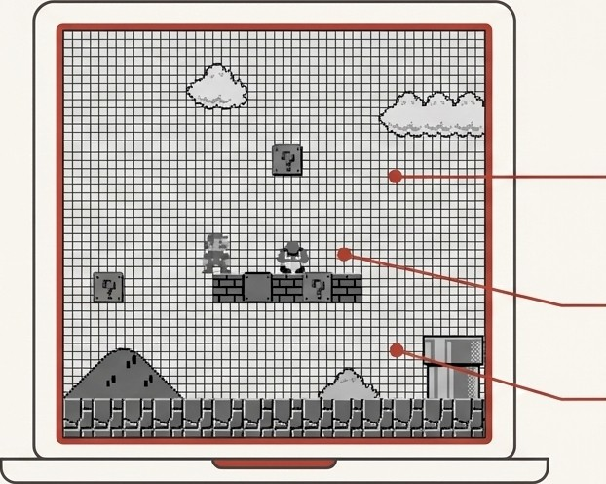



Problem Statement
Goal: Train an agent to conquer World 1-1 by mapping raw pixel inputs directly to optimal actions.
Perception: How to understand obstacles, enemies, and gravity from an infinite state space of pixels?
Exploration: How to overcome the local optimum of standing still to avoid risk?
Sparse Rewards: How to learn the thousands of correct intermediate steps when the final goal is so distant?

Slide 4










Project Objectives
ENVIRONMENT
SETUP
PROCESSING PIPELINE
AGENT TRAINING
PERFORMANCE ANALYSIS
Preprocessing
Pipeline
Agent
Training
Build a Specialized Agent: Developed a modular agent using a Double Deep Q-Network (DDQN), a robust architecture designed to stabilize learning.
Optimize Perception: Implement a rigorous preprocessing pipeline:
Convert frames to grayscale.
Downsample to 84x84 resolution.
Stack 4 consecutive frames to give the agent a sense of motion and velocity.
Train and Evaluate: Execute a training regimen over 8,000 episodes, implementing checkpointing to ensure persistence.
Analyze Performance: Log and visualize key metrics to track the agent's learning journey from novice to expert.
Raw Game
Frames
Preprocessing Pipeline (Stack & Grayscale)
CNN-based Agent DDQN)
Select Action (MoveJump
Log Metrics
& Evaluate

Slide 5
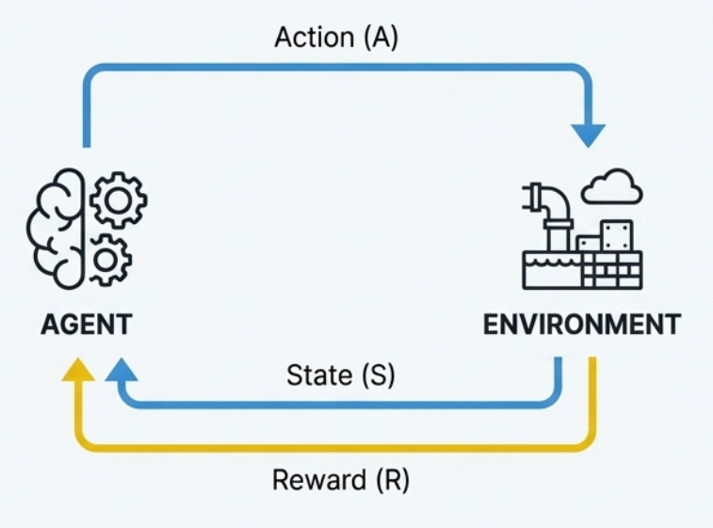




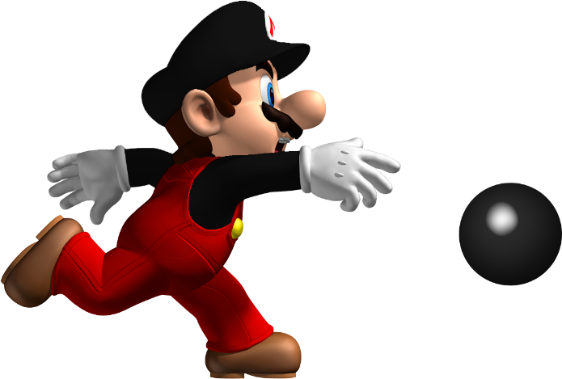

The Principles of Reinforcement Learning
An agent learns by doing. Through trial and error, it interacts with an environment to maximize a cumulative reward signal.
Action (A)
Reward (R):
The feedback from the environment for action
State (S): A snapshot of the environment (in our case, the 4 stacked frames).
Policy (n): The agent's strategy, which maps states to actions.
Action (A): A choice the agent can make (e.g., run right, jump).
AGENT
ENVIRONMENT
Q-Value Q(s,a): The predicted future reward
for taking action 'a' in state 's'. The agent's goal is to
learn the Q-values for the optimal policy.
State (S)

Slide 6
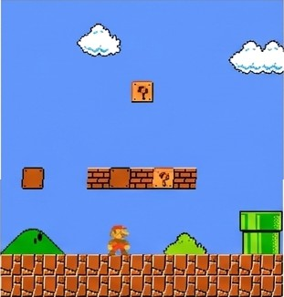
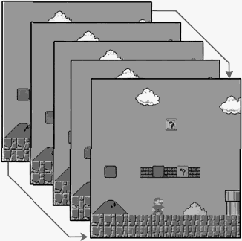
Environment Design
Base Environment:
Gym super mario bros library, focusing on World 1-1.
State Representation:
The 256 possible controller inputs were reduced to just 2 essential actions: Run Right and JUMP while Running Right.This provides a strong inductive bias, focusing the agent's exploration..
Action Space: The agent sees a stack of 4 consecutive 84x84 grayscale frames. This stack allows the CNN to infer motion, velocity and direction. .
Human View
Agent View

Slide 7
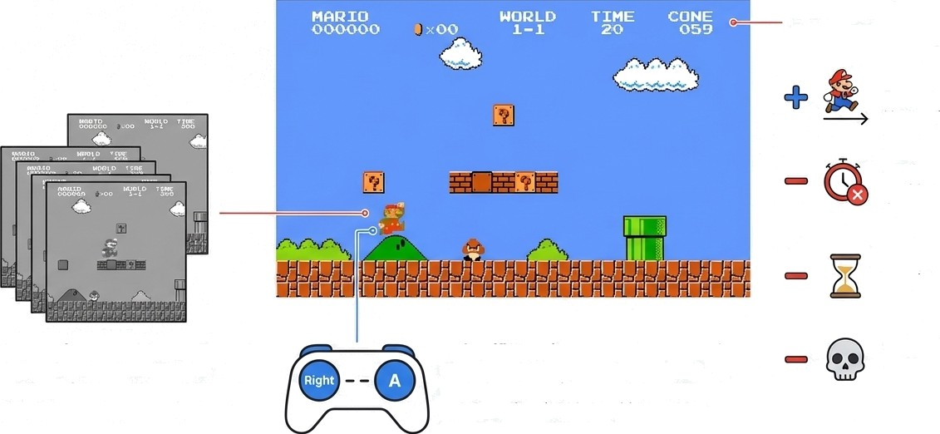
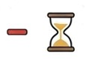
Engineering the Environment for Learning
The Crucial Intervention: Reward Shaping
Progress Incentive: Reward for increasing its X-coordinate.
Stagnation Penalty: -1.0 per frame if horlzonial position doesn't improve for 50 frames.
Living Cost: A small -0.1 penalty per step to encourage speed.
Death Penalty: A massive
-50 to prioritize survival.

Slide 8
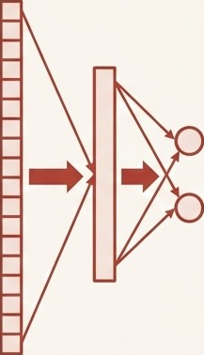
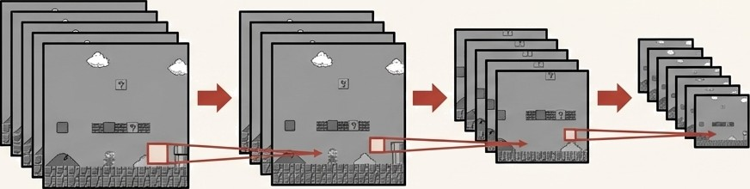

CNN Architecture: The Agent's Eyes
Q-Value
(Run Right)
Q-Value
(Jump Right)
Conv 1
(32 filters, 8x8)
Conv 2
(64 filters, 4x4)
Conv 3
(64 filters, 3x3)
INPUT: 4x84x84 Grayscale Frames Stack
Fully Connected Layers
(512 neurons)
Detects large shapes: ground, sky.
Detects medium features: blocks, pipes.
Detects fine details: enemies.
All followed by ReLU activation

Slide 9
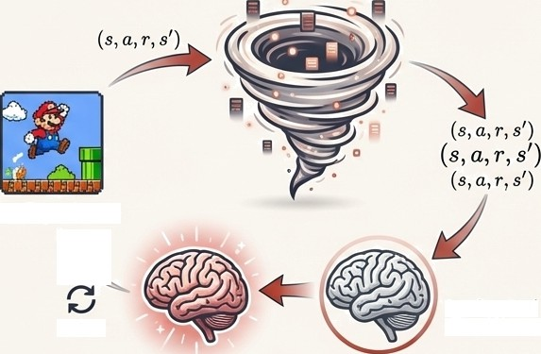

The Training Pipeline
Experience Replay
Stores 60,000 past experiences in a buffer
(LazyMemmapStorage). The agent learns by
sampling from this memory to break correlations and stabilize training.
Epsilon-Greedy Exploration
Balances exploitation (known strategies) with
exploration (new moves). Epsilon decays from 1
(100% random) to 0.1 (10% random).
Target Network
A second, frozen network provides a stable
learning target, preventing the agent from chasing its own tail." Synchronized every 10,000 steps.
Experience Replay Buffer (Memory)
LIVE EXPERINECE
Synchronized every 10k steps
update
Online Network
Target Network
Optimizer: Adam I Episodes: 8,000 | Frames Processed: ~6 Million

Slide 10
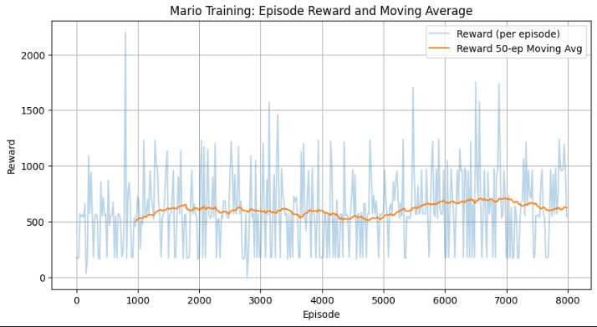
Performance Metrics
Average Reward per Episode: The primary metric for success. 1s the agent progressing and scoring higher?
Episode Length: A proxy for survival. Is the agent living longer?
Mean Q-Value: The agent's confidence. Does it expect higher future rewards as it gets smarter?
Loss: The prediction error. How well is the agent learning to estimate values?

Slide 11
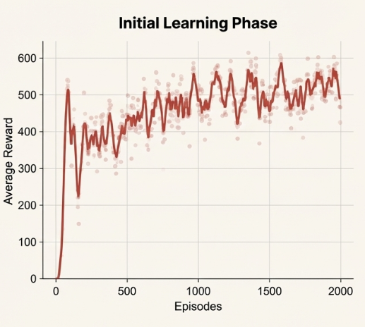
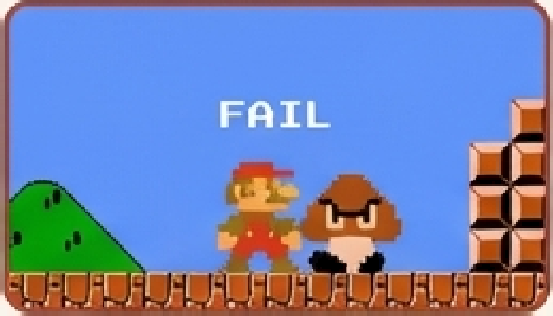
Results: Early Training (Episodes 0 - 2,000)
High Randomness: With epsilon near 1.0, behavior is almost entirely random exploration.
Learning to Survive: Agent quickly learns to avoid the most basic failures, like walking into the first Goomba or falling into the first pit.
Unstable Progress: Reward rises, but is highly volatile. The agent discovers that moving right is good, but lacks the skill to do so consistently.
Agent repeatedly failing in early exploration

Slide 12
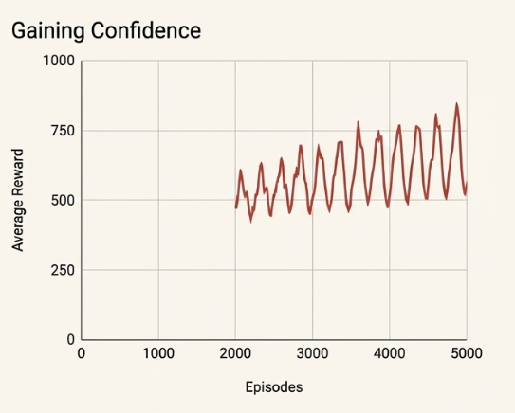
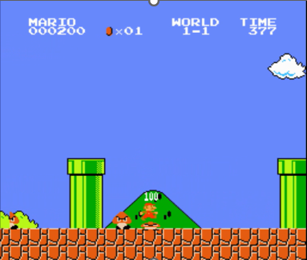
Results: Mid-Training (Episodes 2,OOO - 5,000)
Consistent Navigation: The agent consistently clears early obstacles and learns to time jumps over Goombas and clear gaps.
Policy Stabilization: As epsilon decreases,the policy stabilizes, favoring exploitation of known strategies over pure exploration
Breakthroughs & Failures: The sawtooth pattern shows the agent testing risky strategies some fail, but others lead to breakthroughs and higher rewards.
Agent demonstrating learned
skill:Killing enemy to get rewards

Slide 13




Key Implementation Challenges
Memory Management | Hyperparameter Sensitivity | Checkpointing Hell | The Reward Shaping Dilemma
The 60,000 transition | The learning rate was a | Resuming training after | Early reward functions
replay buffer caused | knife's edge. ‘0.00025’ | a crash required saving | failed to prevent
kernel crashes. Migrating | was the stable optimum | and loading not just | stagnation. The custom
to TorchRL's | between | model weights, but also | ‘Stagnation Penalty’
LazyMemmapStorage' was critical for stability. | catastrophic forgetting and impractically slow learning. | the current ‘epsilon’ value to maintain the decay schedule. | was the key breakthrough after many failed attempts.

Slide 14

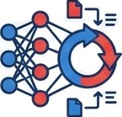


The Next Level: A Roadmap for Future Work
More Advanced Algorithms
Explore PPO for more stable policy updates and A3C to use parallel agents for faster exploration.
Smarter Agent Architecture
Integrate an LSTM layer to give the agent true temporal memory, allowing it to remember events and solve puzzles.
Smarter Training Regimen
Implement Multi-Level Curriculum Learning, training the agent on progressively harder, custom designed levels to build general intelligence.
Smarter Exploration
Use Intrinsic Curiosity Modules to reward the agent for discovering novel states, encouraging natural exploration beyond hand crafted rewards.

Slide 15
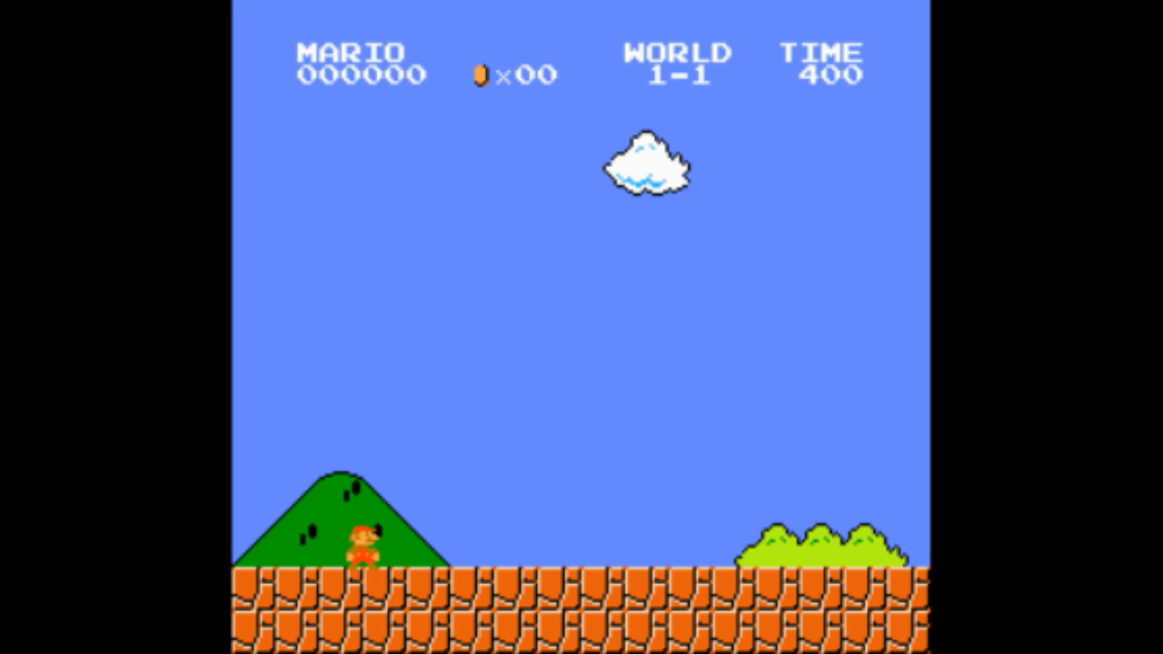
From Pixels to Policy:A Demonstration of DDRL
Summary of Achievement
We successfully trained a DDQN agent to play Super Mario Bros. from raw visual data, overcoming the critical challenge of sparse rewards through targeted
reward engineering.
Key Technical Takeaways
1. Reward Engineering is Paramount: The network architecture provides the capacity to learn, but the reward function determines what is learned. Our stagnation penalty was the decisive factor.
”
"
2. Temporal Context is Mandatory: Frame stacking successfully converted a partially observable problem (static images) into a solvable one by embedding velocity into the state itself.
Broader Impact
The techniques validated here especially the framework for penalizing inaction to solve local optima have direct applications in real world robotics, autonomous navigation and other complex control tasks.
3 Stabilit y Matters: The Double DQN architecture was crucial for mitigating the oscillatory loss and converging to a stable, high performing policy.

Slide 16
THANK YOU

